Slide 1
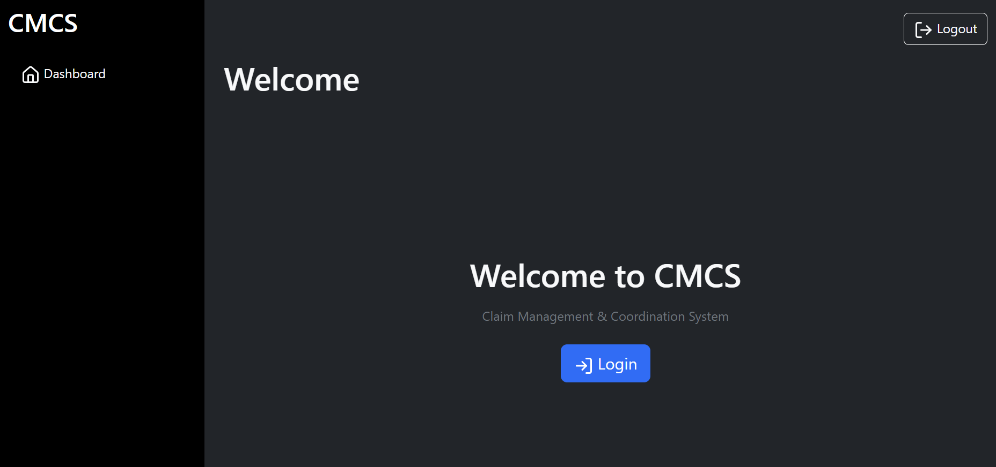
CMCS Contract Monthly Claim System
ST10438433, PRog6212, Caleb forbes
POE part 3 final presentation

Slide 2
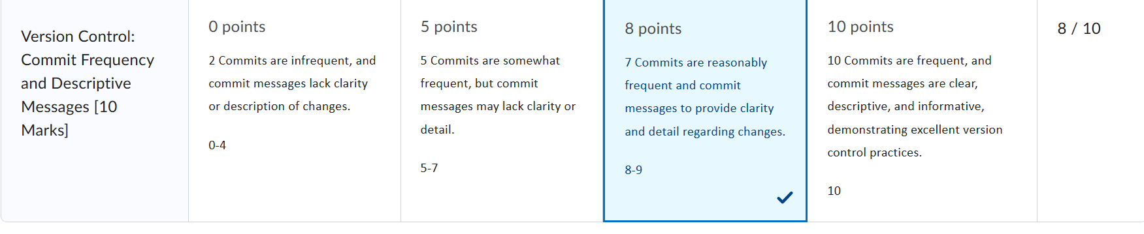
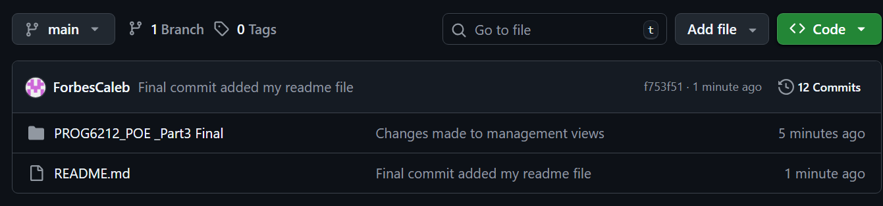
Updates from Feedback from POE Part 2 to Part 3
- Version Control commit frequency and descriptive messages: This shows that I had only gotten 8 as I only did 7 commits but in the next screen shot it shows more than 10 commits

Slide 3
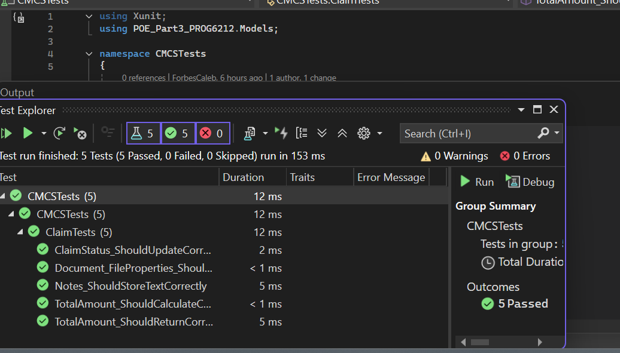
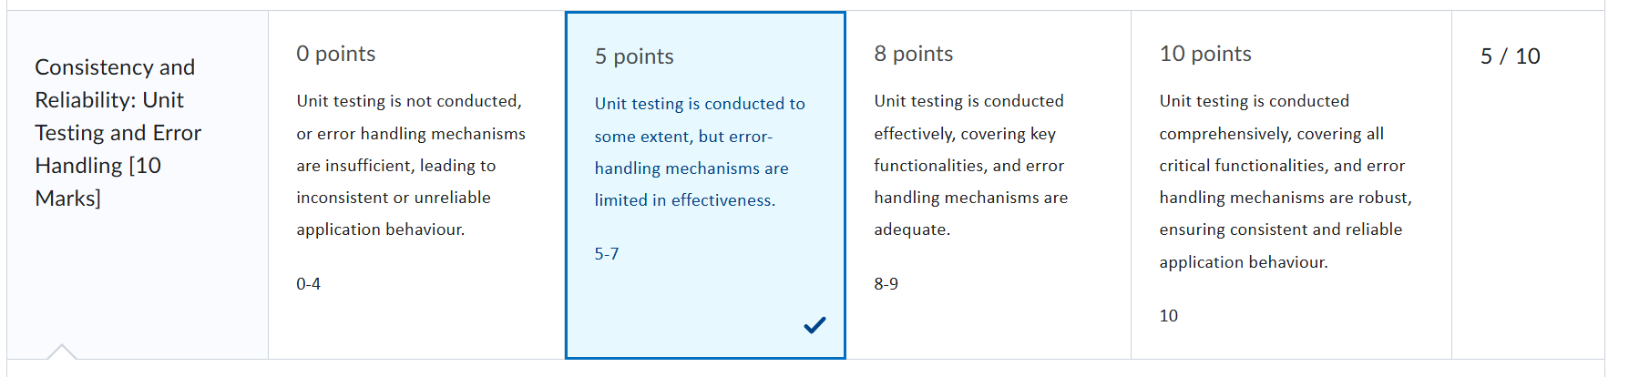
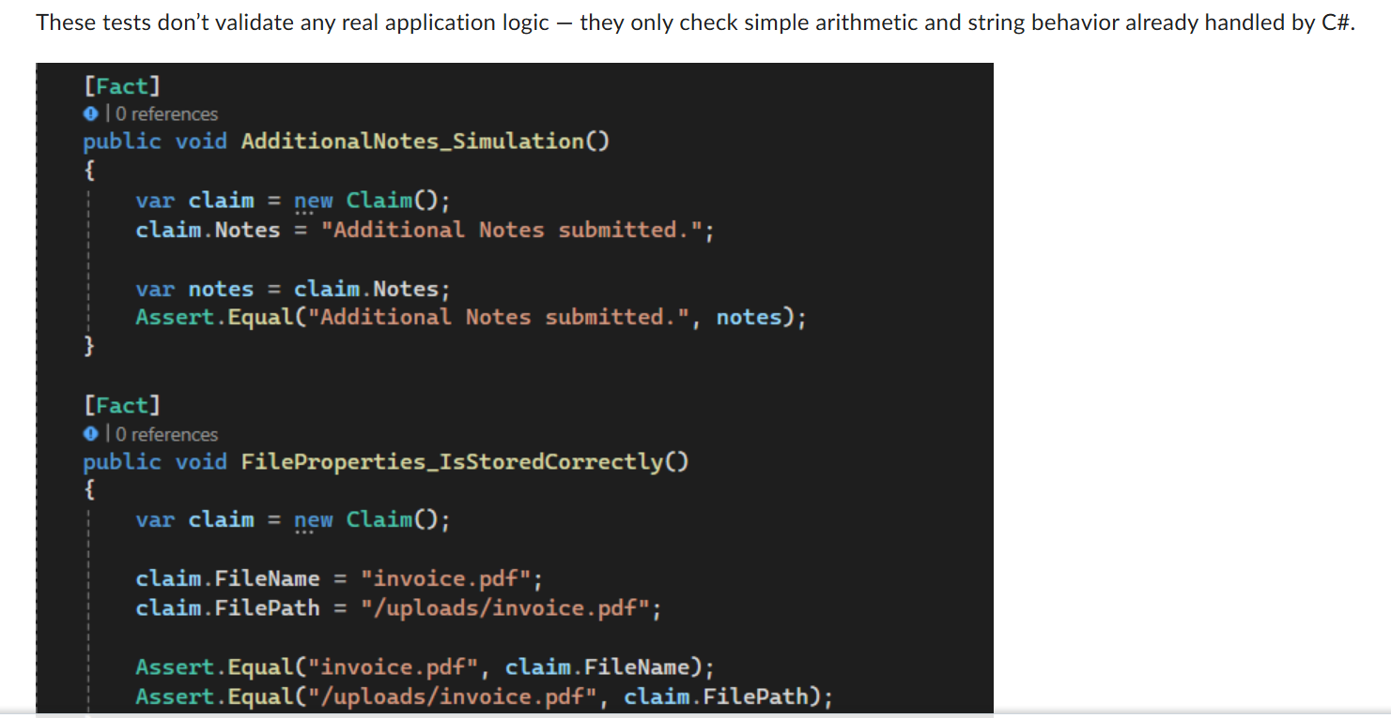
Updates from Feedback from POE Part 2 to Part 3 (Unit testing)
- Tests now validate REAL business logic.
Ensures claim totals and approval logic are correct.
Prevents incorrect outputs and improves reliability.
.

Slide 4
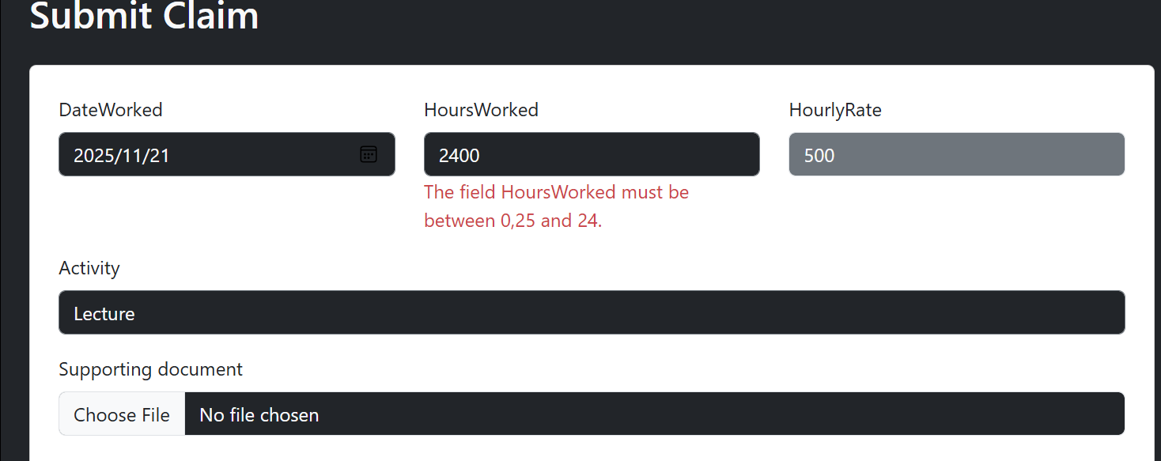
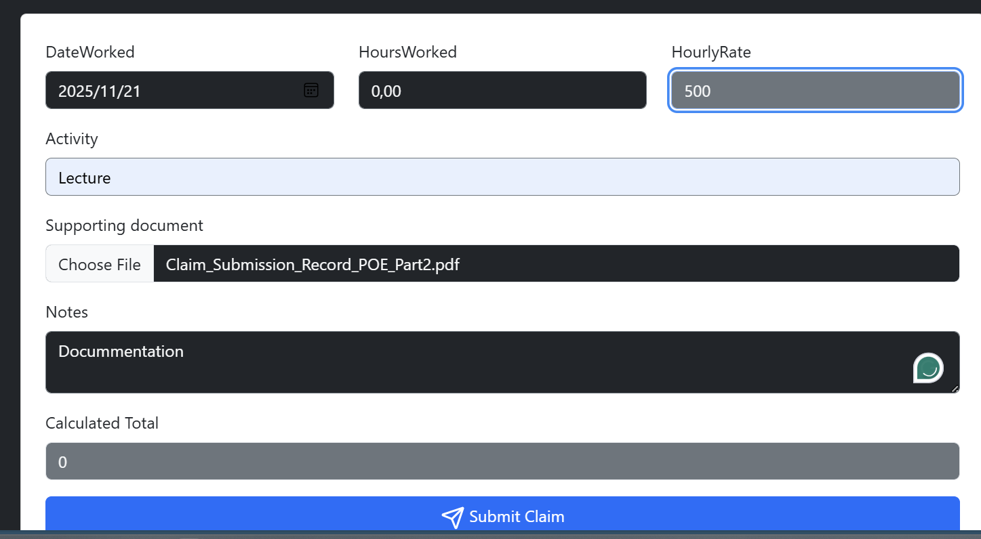
Updates from Feedback from POE Part 2 to Part 3 (Error Handling)
- • Clear validation messages for all errors.
• Prevents crashes during uploads or invalid submissions.
• Only allows for Hr to change hourly rate and not Lecturers
•Also you cant have hours worked be more than 24 hours

Slide 5
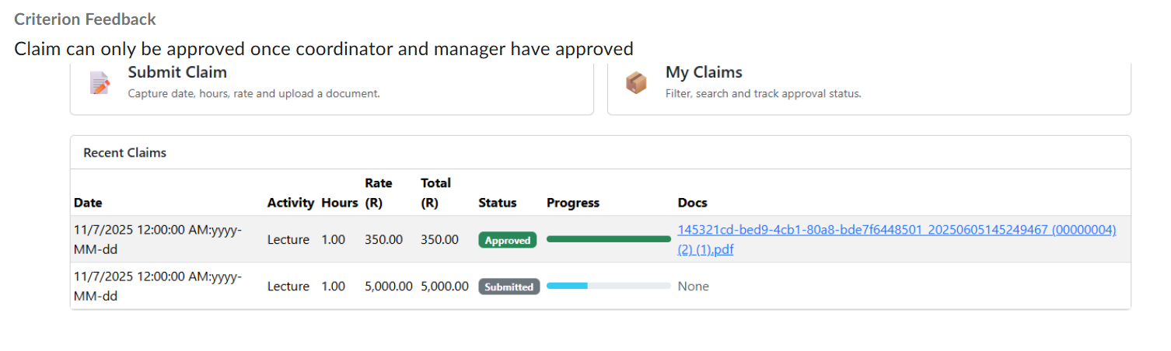
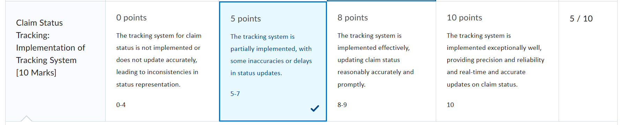
Updates from Feedback from POE Part 2 to Part 3 (Claim Tracking Improvements)
- • Accurate status changes: Submitted - Under Review - Approved.
• Two-step approval enforced (PC + AM).
• Lecturer only sees final approval when both roles confirm.

Slide 6
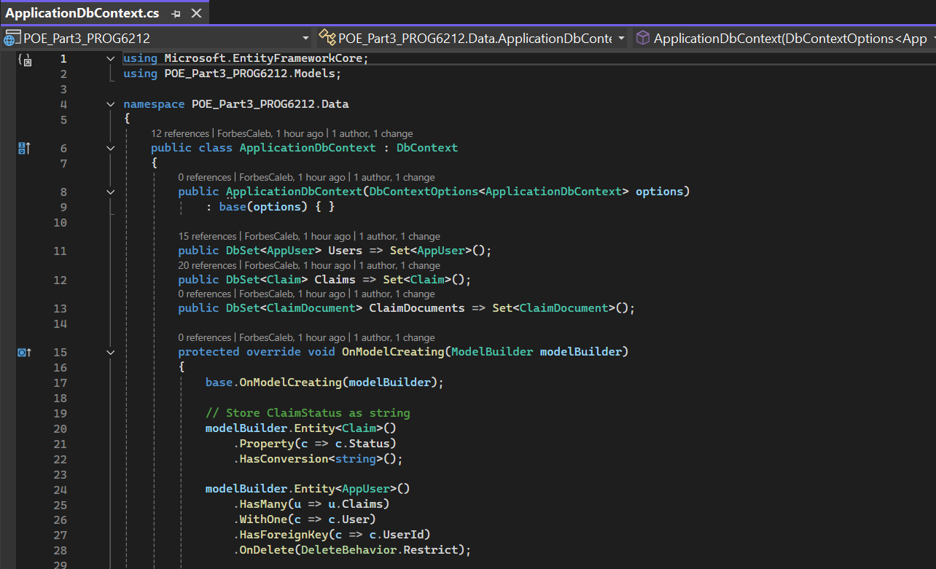
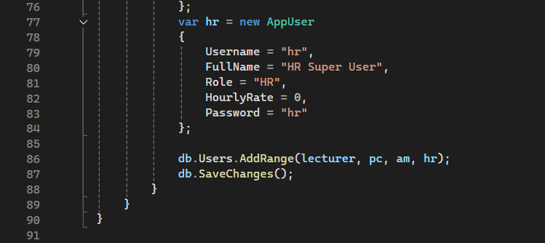
Design and new Features of Part 3 in the web app SQL Integration:
Entity Framework Core is currently used to properly integrate the CMCS system with SQL Server. This indicates that every user account, claim, document, and approval is safely kept in a relational database. Data corruption is prevented by SQL Server's automatic enforcement of foreign key associations, such as tying claims to users. As new features are added, the database schema may be safely updated thanks to the integration's support for migrations. For instance, EF Core migrations were used to smoothly incorporate the professor rate fields, claim documents table, and two-step approval fields. As a result, the system is industry-ready, scalable, and maintainable.
.

Slide 7
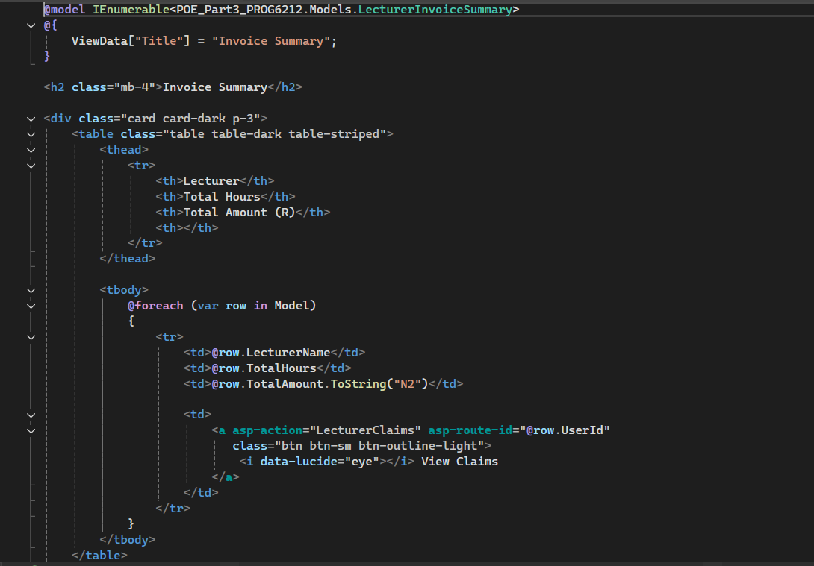
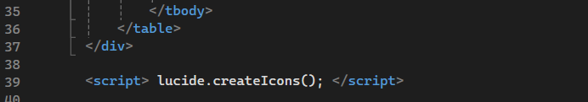
Design and new Features of Part 3 in the Web app Invoice Generation:
My system's invoice creation capability was created to provide HR with a transparent financial summary of all lecturer claims. By classifying authorized claims according to professor, the system automatically creates invoice-style summary. Without the need for human input, this grouping determines the total number of hours worked and the total sum authorized for each lecturer. A thorough drill-down view is also included in the invoice production process. To view a complete breakdown of all claims included in that invoice total, HR can click on any lecturer. This guarantees that HR can precisely verify each amount and increases the transparency of financial tracking.
.

Slide 8
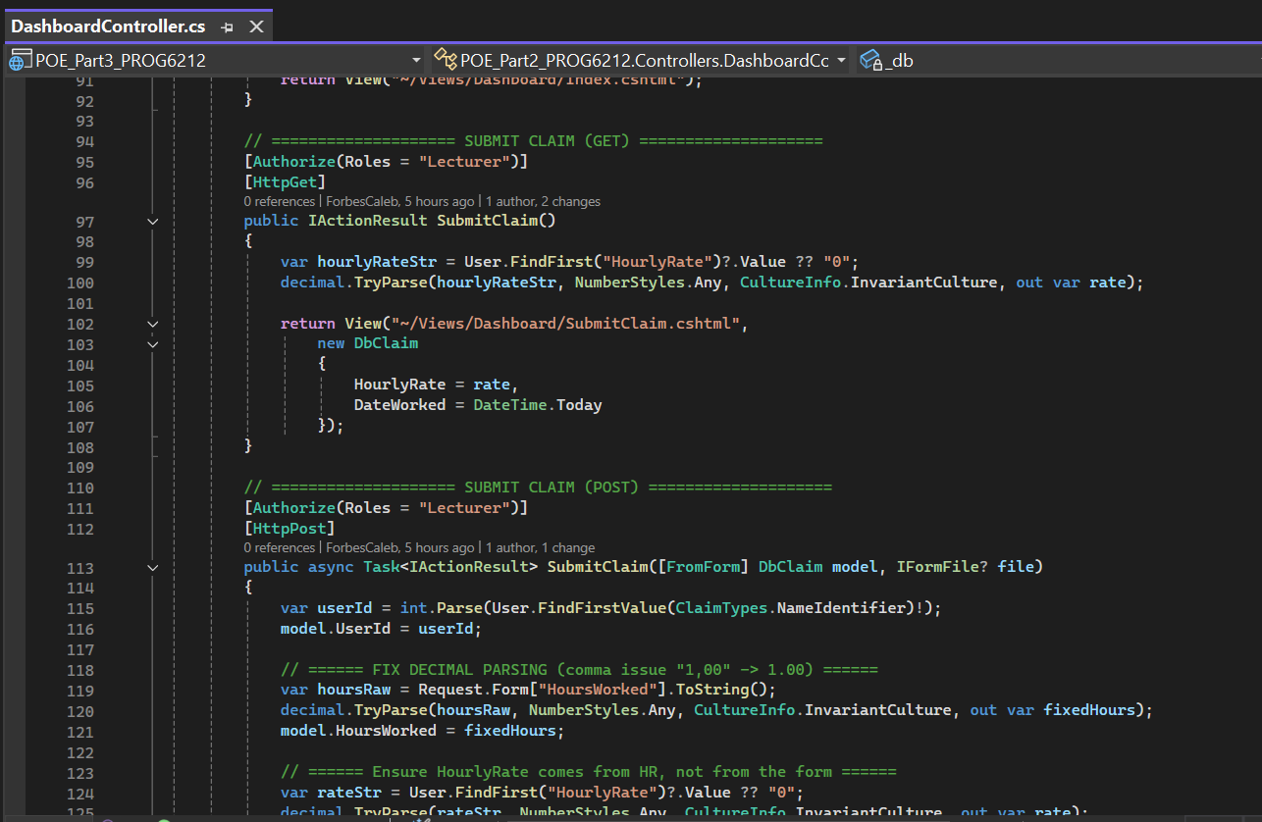
Design and new Features of Part 3 in the Web app Automated Hourly Rate/Total Calculations:
.
.
The system's automatic computation of claim totals based on the lecturer's hourly rate is another significant improvement. The system now retrieves the hourly rate straight from the user's profile, eliminating the need for lecturers to manually enter their rate, which frequently results in errors or discrepancies. The system automatically determines the following when a lecturer files a claim: Hours Worked × Hourly Rate = Total Amount This eliminates laborious calculations, increases uniformity, and lowers errors. Additionally, it facilitates the two-step approval process, guaranteeing that academic managers and program coordinators can examine precise financial data.

Slide 9
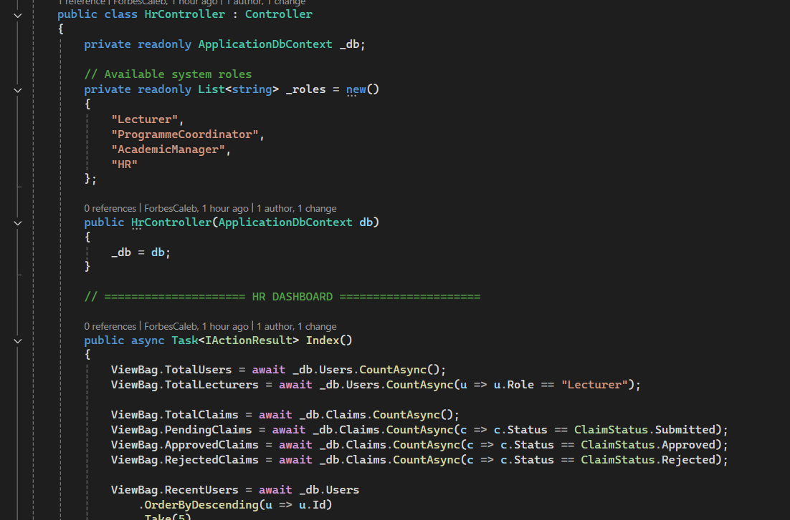
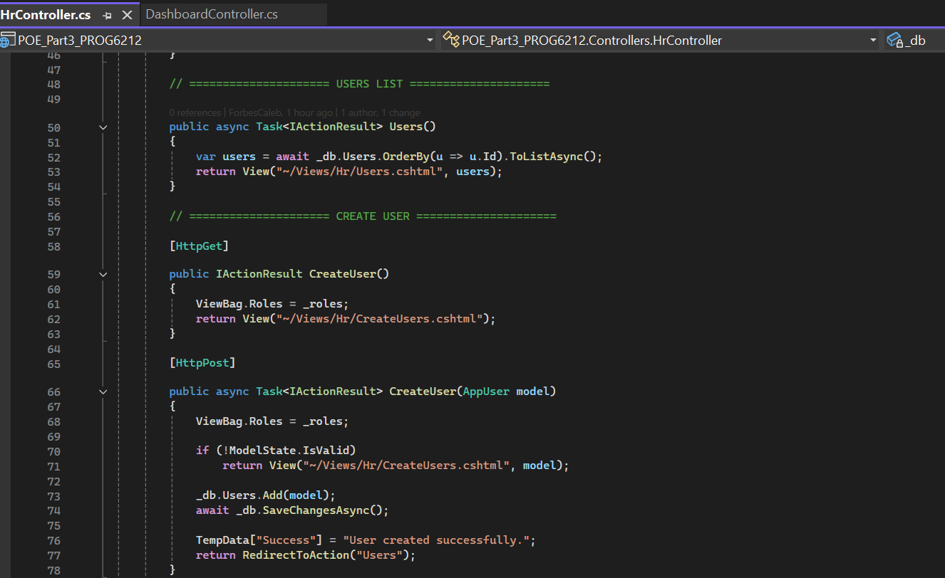
Design and new Features of Part 3 in the Web app HR Super User:
.
.
The inclusion of a full HR position in the latest version of the CMCS system is one of its most significant enhancements. Lecturers, program coordinators, academic managers, and even other HR users can now be created, edited, and deleted by HR. HR may view the overall number of users, lecturers, claims, and recent activity through the HR dashboard, which offers system-wide access. This improvement takes the system closer to an actual institutional setting and grants HR complete administrative authority. Because HR no longer relies on developers to manually manage people, it also enhances workflow.

Slide 10
Thank You

